Slide 1
Capstone Final Slides
Emilio Osmena

Slide 2
Problem
NBA players are being paid more now than ever
The problem is that there is no way to tangibly measure who NBA General Managers offer the maximum contract
By using data from basketballreference.com I created a model used to predict an NBA maximum contract offer

Slide 3
The Data
The data contains 64 Rows and 30 Columns with basic NBA stats of 11 guards
5 guards have a max contracts, and 5 guards don’t have a max contracts. The last player(Devin Booker)is eligible for a max contract this year.
All the data was pulled from basketballreference.com

Slide 4
Data Wrangling
The data included full season injuries, so I found those years and dropped them.
The data also contained redundant columns like position and league, so we also dropped those columns to avoid multicollinearity issues

Slide 5
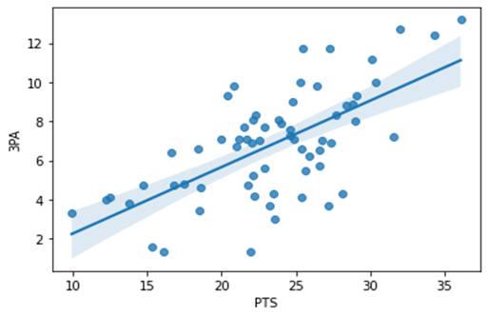
Exploratory Data Analysis
I initially looked at a heatmap and correlation stats to find that 3PA heavily influenced PTS.
Regplot was used to determine the linearity of the 3PA and PTS
We are comparing Devin Booker with other max contract players

Slide 6
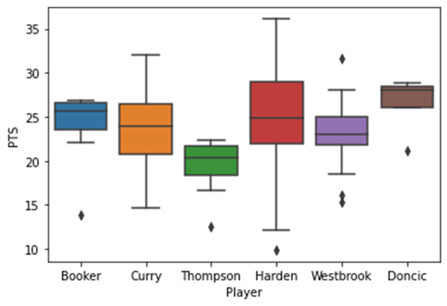
Player PTS Comparison
Booker had many seasons of 22 or more PTS with many being about 26 PTS
Max contract players are in very similar ranges of seasons in PTS.
Booker is just hitting his prime, so his future looks very promising

Slide 7
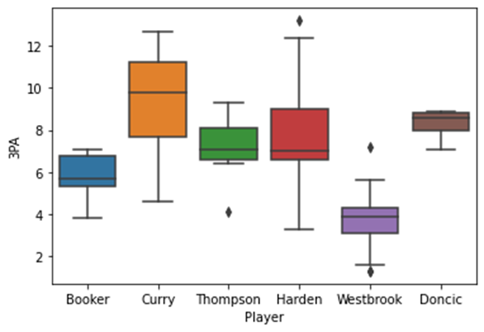
Player 3PA Comparison
Booker had on a little below 6 3PA per game seasons, while max contract players hovered in the 6-10 3PA
This is an area Devin Booker can improve on

Slide 8
Model Selection
We tested the parameters around who was offered a maximum contract and who was not offered a maximum contract. The mindset of the NBA owners is more recall, so that is the method I focused on.

Slide 9
Random Forest
The Random Forest model had an average Recall score of 0.89. Its Precision and F1 scores were also similarly high. We may have to consider overfitting since all scores are close to or at 0.9.

Slide 10
Decision Tree
The Decision Tree model had an average Recall score of 0.69. It had a surprisingly low recall score when predicting NBA teams offering the max contract. That means the model tends to offer a maximum contract often.
This model can be useful if you are trying to filter players early in their career for future max contracts

Slide 11
Gradient Boosting
The Gradient Boosting model had an average Recall score of 0.84. This model had the most hyperparameter tuning. There was a sweet spot for number of estimators, random states, and max depth. The average score went from 0.66 all the way up to 0.84. After the adjustments, all scores were in the low 0.80s and performed the most consistently amongst models.

Slide 12
Improving Model for the Future
I would like to expand this model to include all players/positions who were offered a maximum contract to increase the data size
Basic NBA stats were used, and more advanced stats could be added in the future

Slide 13
Conclusion
The Suns team should offer Devin Booker a maximum contract at the end of the season. The Gradient Boosting model is also the best of the three models in predicting Maximum contracts.

